Slide 1
Communicating Crisis & Risk Messages that Motivate Resilience
Brooke Liu, Ph.D.
Associate Professor of Communication & Director of the Risk Communication & Resilience Program, START
This research was supported by the Science and Technology Directorate of the U.S. Department of Homeland Security through Contract Award Number HSHQDC-10-A-BOACopyright © 2014, University of Maryland, All Rights Reserved
6/HSHQDC-12-J-00145 through START. Any opinions, findings, conclusions or recommendations presented here are solely the authors’ and are not representative of DHS or the United States Government.

Slide 2
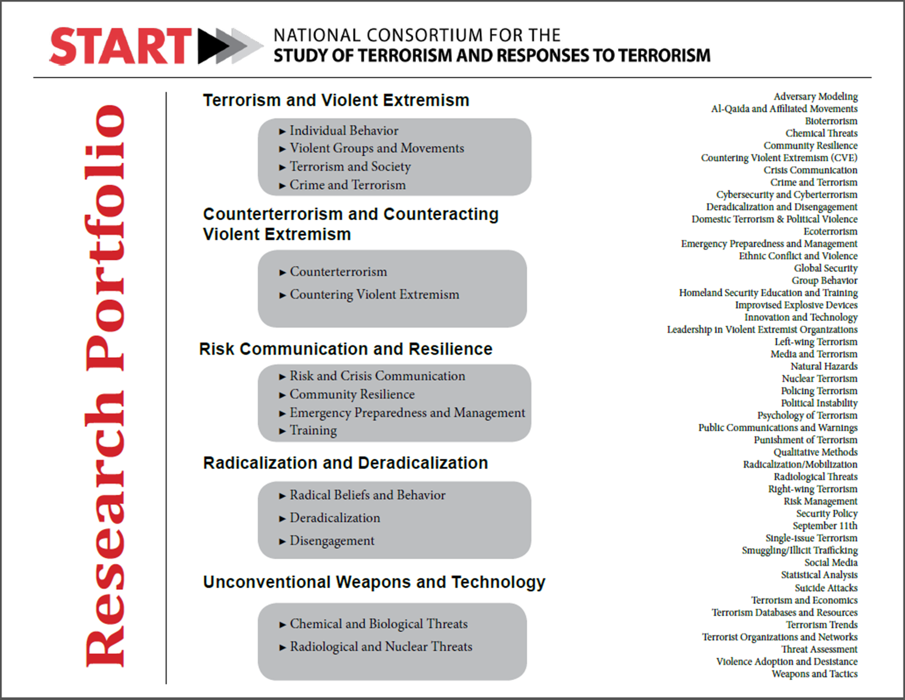
Introduction to START
Terrorism Studies Minor
Graduate Certificate
Training/Continuing Education Units
More than 20 publically available data sets
Access to over 200 SMEs
100s of articles, thousands of HSE students trained

Slide 3
Research Presentation Overview
Social media use before & during disasters
Mobile
Mobile messaging for imminent threats
Traditional
Journalists’ perceptions of social media’s value
Social

Slide 4
Conclude with Bridging the Gaps
Image source: http://www.mu-sigma.com

Slide 5
Part I: Social Media Use Before & During Disasters

Slide 6
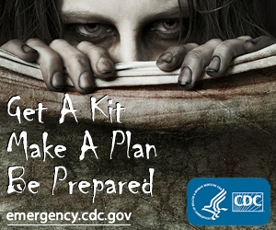
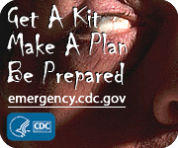
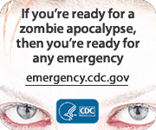
Case Study: CDC’s Zombie Apocalypse Preparedness Campaign
Images source: emergency.cdc.gov

Slide 7
Blog Promoted by Tweet
Image source: Twitter

Slide 8
Campaign Goes Viral
Image source: Facebook
Exceeds 60,000 blog page views/ hour within 3 days –
up from about 80 blog page views/ hour prior to the promotion
Top 10 Trend on Twitter

Slide 9
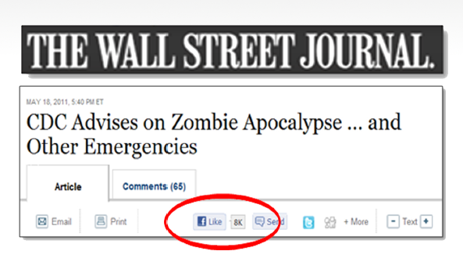
Picked Up by Traditional Media
More than 3.67 billion total impressions
Image source: CDC campaign evaluation metric materials

Slide 10
Case Study: Key Findings
Social Media vs. Traditional Media
Medium is the message in other work
Humor (Zombie) vs. Non-Humor (All Hazards)
No differences among groups in this study
Zombie messaging = lower intentions to: prepare a kit, make a plan, & seek further info

Slide 11
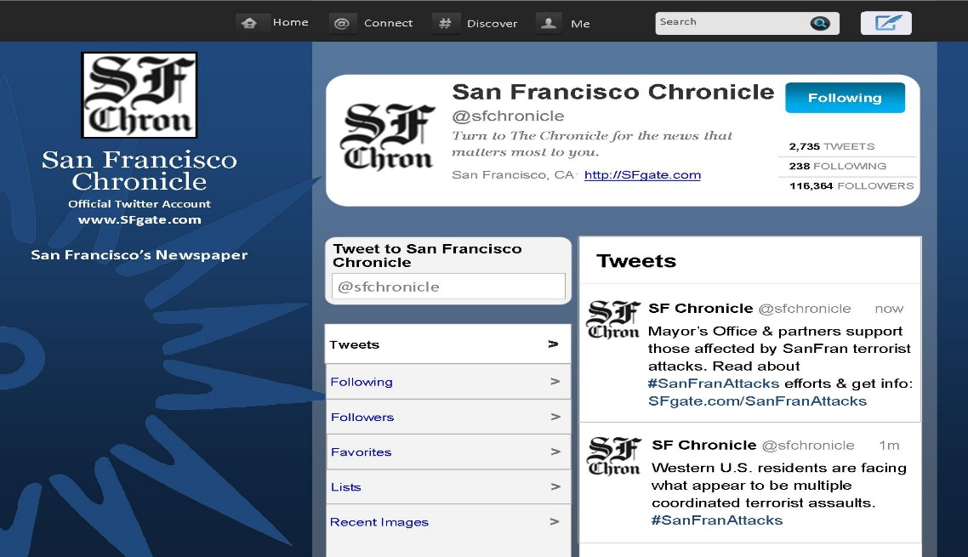
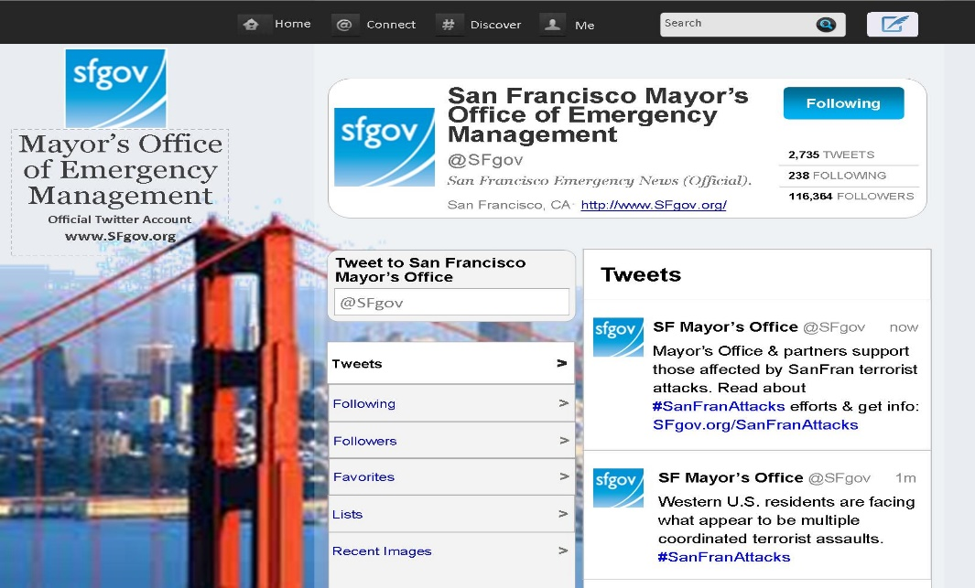
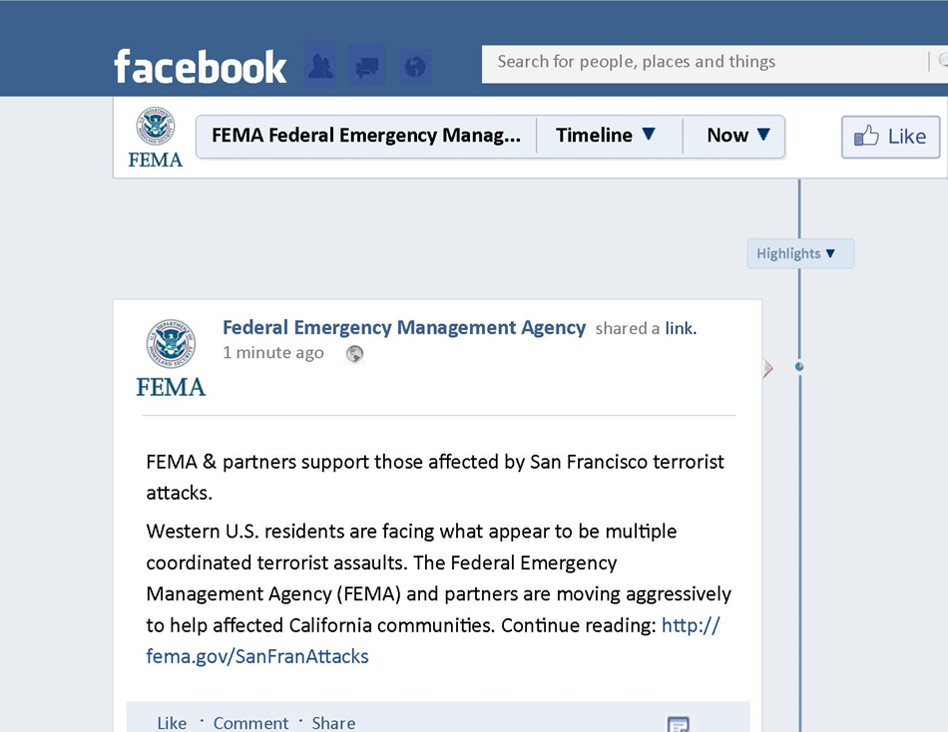
Social Media Use during Disasters

Slide 12
START Experiment Results

Slide 13
START Experiment Results

Slide 14
START Experiment Results

Slide 15
Part II: Mobile Messaging for Imminent Threats

Slide 16
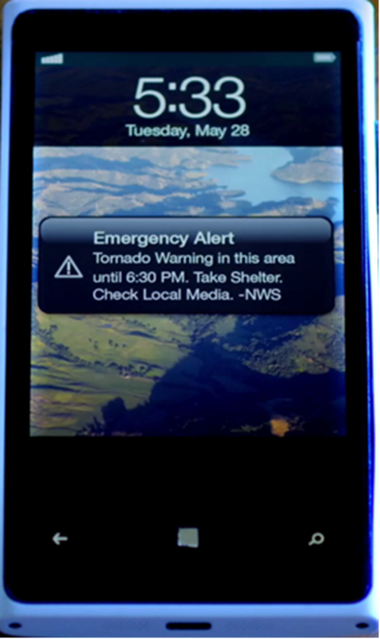
WEA Messages
Content topics & order are set:
Hazard, location, time, protective action, source
Photo credit: slate.com

Slide 17
How to best order content?
Current short messages order:
Hazard, location, time, protective action, source
Revised short messages order:
Source, protective action, hazard, location, time

Slide 18
Do recommendations vary by hazard?
Short messages (90 & 140-characters):
Too little info to overcome pre-event hazard-specific perceptions
Longer messages (1,380-characters):
Enough info to shape public perception & event response
More like a siren than warning
Works across hazard types

Slide 19
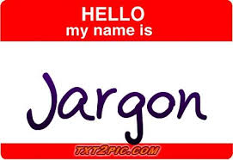
Familiarity Concerns
WEAs
Alert & warning concepts

Slide 20
Do WEAs work?
About 1/3 of survey respondents had been checking local media, with an increase to almost 50% within 15 minutes following the 1st WEA

Slide 21
Part III: Journalists’ Perceptions of Social Media’s Value during Disasters

Slide 22
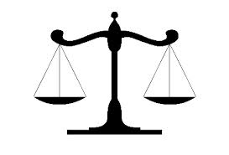
Why use social media?
Breaking health & safety news
Finding sources & fact checking
Cross-promote news content
Not for deep storytelling
Speed
Accuracy

Slide 23
Cross-Study Conclusions
Risk communication objectives
Specific audience deficiencies
Messages matter, if done well
Specific message areas to improve
Messages over medium for response

Slide 24
Research in the Works….
Image credit: http://www.funkyland.com

Slide 25
Bridging Gaps between the Academy & Government Agencies

Slide 26
Questions?
Brooke Liu, Ph.D.
Associate Professor and Director of the Risk Communication & Resilience Stream
bfliu@umd.edu
www.start.umd.edu

