Slide 1
#freematt: Nascar’s Blunder That Became a Hashtag
Dr. Angela Jerome
&
Michaela Ash
Western Kentucky University

Slide 2
Learning Objectives
For audience members to further understand the unique sphere of sports image repair
For audience members to further consider the intricacies of audience analysis in 2015
For audience members to further explore the impact of social media on crisis response and public image

Slide 3
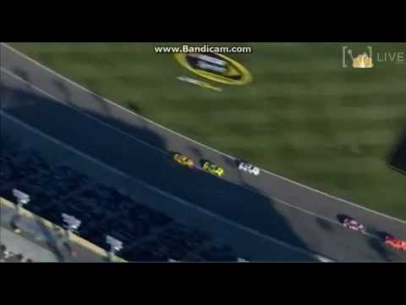
Case Background
Logano wrecks Kenseth
October 18, 2015

Slide 4
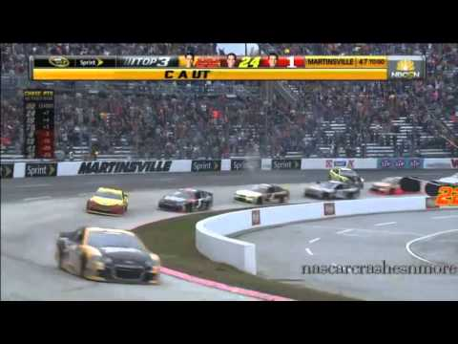
Case Background
Kenseth wrecks Logano
November 1, 2015

Slide 5
Unique Situational Factors

Slide 6
Key Findings

Slide 7
Lessons for Crisis Practitioners

