Slide 1




Picture This and Take That:
Strategic Crisis Visuals and Visual Social Media (VSM) in Crisis Communication
ICRC 2016
Yan Jin
University of Georgia
Lucinda Austin
Elon University
Jeanine Guidry
Virginia Commonwealth University
Candace Parrish
Virginia Commonwealth University

Slide 2
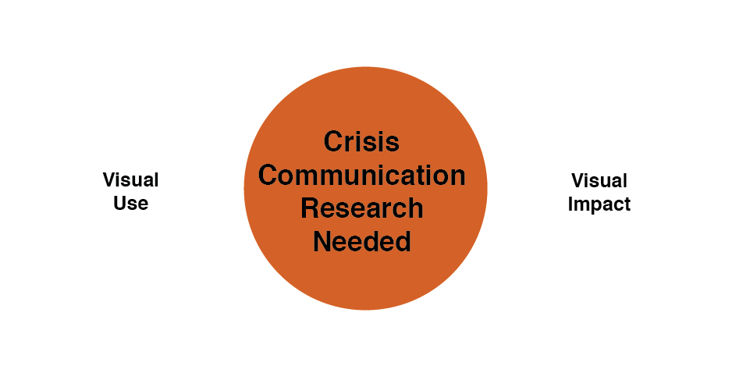
Visual Use in Crisis
Notes:
• Visual use in Crisis Communication is an under-researched area
• Research is needed on the effect of visuals on publics’ perceptions of crisis responsibility (Coombs & Holladay, 2011)

Slide 3
Visual Use in Crisis
• Visuals can be both form and content
• Visual can be presented and disseminated more appealingly and effectively
• Visuals are often used as contextual elements in crisis storytelling

Slide 4
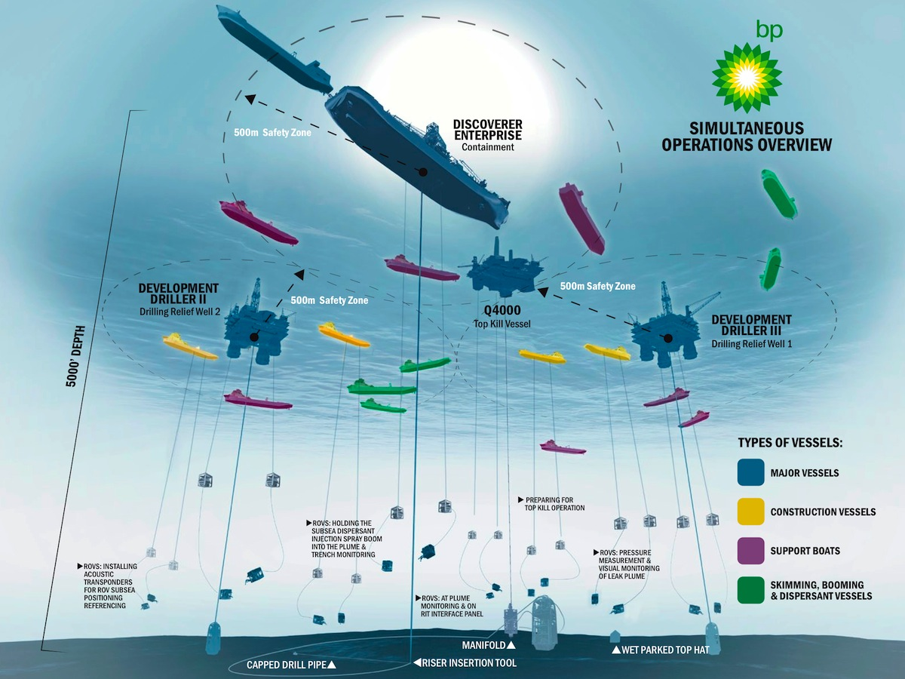
BP Oil Spill graphic as Form

Slide 5
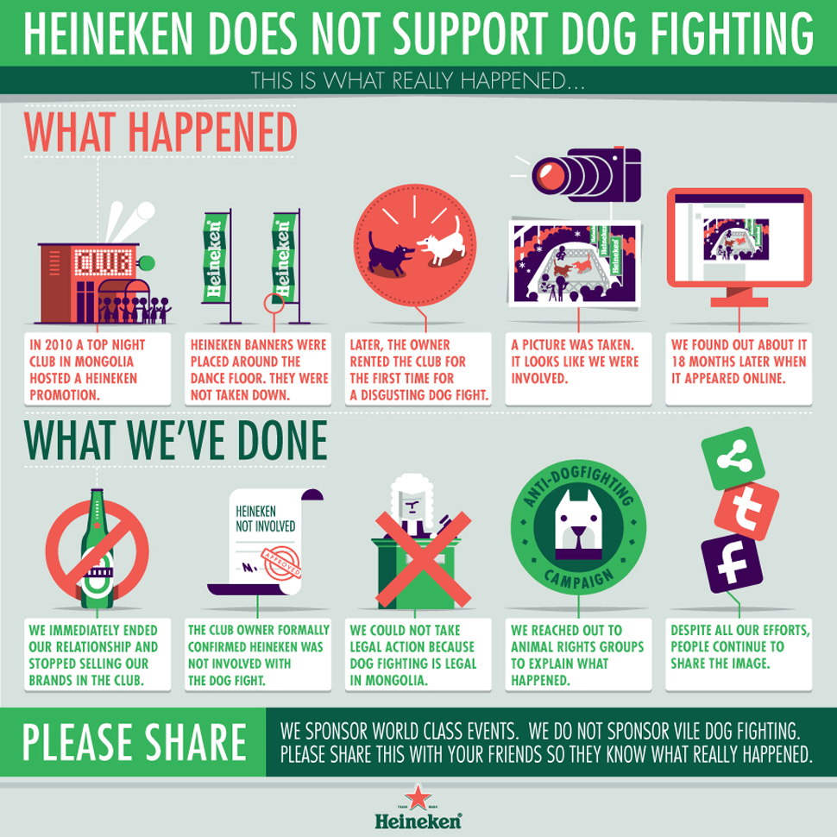
Heineken Dog Fight Infographic as Form and Content

Slide 6
Impacting Factors
• Source of visuals can impact the context of visuals in crisis communication
• Individuals with low literacy levels often engage with visual communication better
• Our presentation will propose how Visual Social Media (VSM) might enhance crisis communication effectiveness

Slide 7

LA Clippers “We Are One” Branding Visual after firing of openly discriminatory Owner, Donald Sterling

Slide 8
Dissecting Crisis Visuals
• Images can both communicate and influence public opinion
• Visuals as storytelling tactics work effectively in the digital landscape
• Further validating research on the effects of crisis visuals

Slide 9
Defining Crisis Visuals
• Images alone or in combination with text or other image(s)
• Selected and incorporated strategically by an organization
• Disseminated to and/or shared with primary publics
• Making crisis information content more concrete, coherent, or comprehensible

Slide 10
Crisis Visuals & Info Processing
• Elaboration Likelihood Model: Peripheral vs. Central Processing
• A centrally processing audience would likely be more persuaded by strong arguments
• Messages need to enhance publics’ motivation and ability to process the crisis information

Slide 11
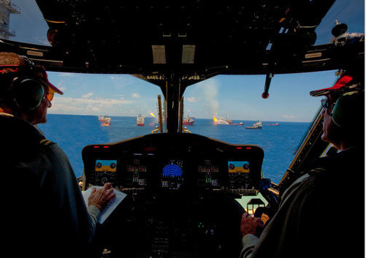
Photoshop Enhanced Image released from BP as crisis visual

Slide 12
Framing Effects
• Visual Framing: visual human-interest framing and visual political framing
• Crisis visuals with human interest + strong cultural and geographical connections are likely to be most newsworthy
• These visuals are more likely to be utilized and shared by media professionals

Slide 13
Emotional Impact
• Emotion-evoking visuals can cause people to think more rationally
• Theory of Affective intelligence
• Visuals can enable a sense of interactions without first-hand experience

Slide 14
Crisis Visuals on Social Media
• Extant research highlights “good” elements of crisis messaging on social media
• Crisis visuals can serve as triggers, amplifiers, catalysts, and/or symbols of recovery of a crisis
• Crisis visuals can be posted and shared by non-visual dominant social media platforms and VSM

Slide 15
Dominant Visual Social Media (VSM) Platforms
Notes:
• Currently, Instagram & Pinterest have higher adoption rates by organizations in public relations functions
• In 2015, Instagram reached 400 million monthly active users
• Approximately 28 percent of online U.S. adults 18 and older use Pinterest

Slide 16
State of VSM Use of Crisis
“Pinterest and Instagram have emerged as leading channels for brand and product discovery, so it’s no surprise that those platforms are evolving their ad offerings to better bridge the gap between social media and commerce.”
Jasper Nathaniel
VP of Business Development, Crowdtap

Slide 17
State of VSM Use of Crisis
• Currently, VSM are typically used branding and engagement communication purposes
Ex. Showcase Products or Introduce Employees
• There is potential for increased brand management success in using VSM during periods of Crisis

Slide 18
Multimodal Crisis Communication on VSM
• Geise and Baden (2015) defined modality as visual and textual information
• Visual and textual modalities vary according to different degrees of structuring and salience
• Modality logic centers around Visual Information Processing (VIP)

Slide 19
Practical Implications
• Crisis visual perception and structuring
• Crisis visual decoding
• Connection of crisis visual elements
• Construction of coherent meaning with visual and textual elements in crisis visuals and on VSM

Slide 21
Conclusion/Future Research
• VSM are influential information content creators and form innovators
• Both visual and textual elements should be used in creation of crisis visuals
• Future empirical research should explore the function of crisis visuals and VSM in crisis communication

Slide 22
Questions?
Yan Jin, Ph.D.
Associate Professor
Associate Director, Center for Health & Risk Communication
University of Georgia

