Slide 1
Awareness-raising of ecosystem service and disaster risk reduction among young generation
2016 International Conference on Crisis & Risk Communication
March 7-9, 2016
Naoko Kimura
PhD student,
Graduate School of Global Environmental Studies
Kyoto University

Slide 2
Background
Background
Method
Results
Objective
Discussions
Conclusion & Next
Ecosystem and disaster risk reduction
Ecosystem and its role in Disaster Risk Reduction (DRR) and discussions around related concepts:
Increasingly recognized as a means not only to attain ecosystem-based DRR but also to contribute to sustainable development (Peduzzi et al., 2010).
The discussion on inter-relation between ecosystem conservation and DRR have always been paralleled (Renaud et al., 2013).
A rethink of how we relate to one another and how we interact with the ecosystems that support our lives is required; yet
Few working cases on those topics and the tangible practice remain far from mainstream (UNISDR, 2011, 2013).

Slide 3
Background
Background
Method
Results
Objective
Discussions
Conclusion & Next
Educating and empowering the young generation
Education for Sustainable Development (ESD) [2005-2014]
Responds to local specificities and respects cultural diversity (UNESCO, 2014)
Use of formal and informal channels to reach youth and children with information (Hyogo Framework for Action 2005-2015)
The Global Action Programme (GAP) on ESD [2013]
Priority 4: Empowering and mobilizing youth
A two-fold approach for integration:
Sustainable development
Education

Slide 4
Objective & Method
Background
Method
Results
Objective
Discussions
Conclusion & Next
To see how young generation perceives functions of provisioning service, regulating service, and culture service of ecosystem;
Especially, to see to what extent they recognize functions of regulating service as the important; and
To seek a possibility to connect local environment ecosystem and local disaster experience
Lecture (dialogue)
Matrix-making
Group discussion
Analysis

Slide 5
Method
Background
Method
Results
Objective
Discussions
Conclusion & Next
Workshop (a pilot project)
Targeted group:
- Shiga Prefectural Moriyama High School
- High school students (grade 1st and 2nd)
- Participants: 19 students
Date and Time:
- 2nd August 2015 and 21st November 2015
- 3 hours (13:00-16:00)
Why high school students?
- Completed basic biology, geography, and geology for comprehension on basic items related to connectivity in a Basin and ecosystem services/functions
- Before getting into youth age (c.f. GAP priority 4: empowering and mobilizing youth)

Slide 6
Method
Background
Method
Results
Objective
Discussions
Conclusion & Next
Making a matrix in a group work & Lecture
Time | Contents
13:00 | Self-Introduction & Icebreaking - Items imaged when you hear “water” - Grouping based on the answer to the above
13:10 | Lecture - Where did water come from? / Existing water on the Earth - Water Cycle - History of Lake Biwa - Lake Biwa and its Basin
13:30 | Lecture (Dialogue style) - Human activities around Lake Biwa : water that is close to us and water that is distant from us - Ecosystem services of freshwater environment (around Lake Biwa)
13:50 | Break (UAV)
14:20 | Group work (Matrix making) - Matrix-making: functions of freshwater ecosystem services based on the following two axes “functions that are felt close to us” and “functions that are felt not close to us” “functions that is to be the most important (prioritized)” and “functions that can be less important (prioritized)” - To exchange opinions and reasons for their categorizing those functions within each group - Finalize their matrix in each group
15:00 | Group Presentations & Discussion - Each group to present the result of their matrix together with the reasons - Q&A and discussion between the presenting group and the other audience groups
15:40 | Dialogue and summary
16:00 | Closing

Slide 7
Method
Background
Method
Results
Objective
Discussions
Conclusion & Next
Freshwater environment (Lake Basin) Ecosystem services
Provisioning
Service
1. Water supplies 2. Fish
3. Wood and fiber 4. Fuel
5. Irrigation crops 6. Hydropower potential etc.
Regulating
Service
Flood and drought mitigation 8. Self-purification capacity
Navigation routes 10. Climate mediation
11. Aquatic habitats 12. Diverse food-chains
13. Sound water quality 14. Health provisions
15. Ecotone buffer capacity 16. Fertile lands
Culture
Service
17. Aesthetic and scenic values 18. Recreational values
Religious sites 20. Spiritual values
21. Educational resources
Supporting
Service
Heat energy, Geological Formation, Physical structure,
Nutrient cycling, Primary production
Source: ILEC (2007)
7

Slide 8
Method
Background
Method
Results
Objective
Discussions
Conclusion & Next
3. Analysis of the results out of group work and discussion
the most important / to be prioritized
Why these axes?
I
The Constructivist Theory
Learners obtain and develop their new ideas and concepts using their current or past knowledge;
Leaning is not a simple knowledge transfer but a process to produce the meaning (Bruner, 1960)
II
not close to us
close to us
Legitimate peripheral participation in communities of Practice
Learning = a process of becoming to play important roles in communities of practice (Lave and Wenger, 1991) → simulated experience
III
IV
can be less important / less prioritized

Slide 9
Results
Background
Method
Results
Objective
Discussions
Conclusion & Next
5 groups – Icebreaking “What comes to your mind when you hear ‘water’?”
“Life” (5) “Climate” (3) “Image” (3) “River” (4) “Fish” (4)
Table.1 Legend of ecosystem services and the number of each function in the matrix
Provisioning service | Regulating service | Culture service
Water supplies Fish Wood and fiber Fuel Irrigation crops Hydropower potential | Flood and drought mitigation capacity Self-purification capacity Navigation routes Climate mediation Aquatic habitats Diverse food-chains Sound water quality Health provisions Ecotone buffer capacity Fertile lands | Aesthetic and scenic values Recreational values Religious sites Spiritual values Educational resources

Slide 10
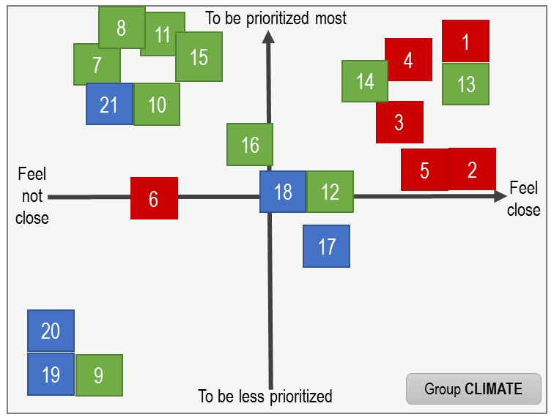
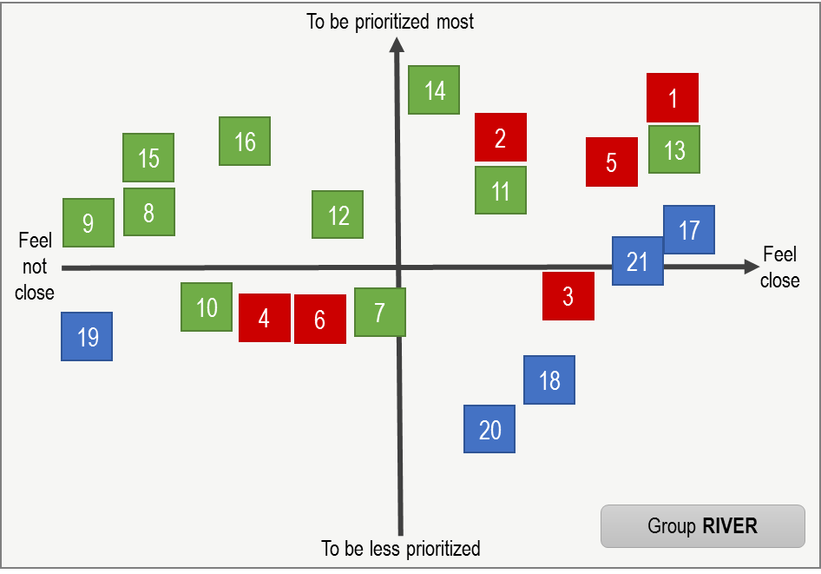
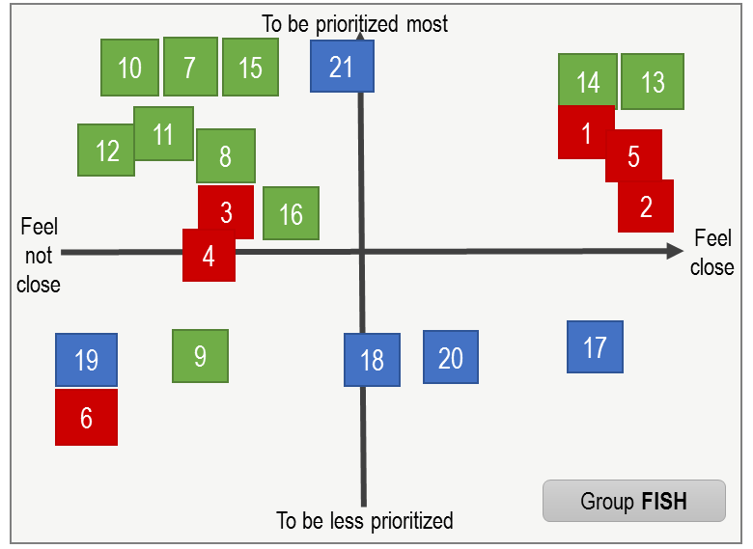
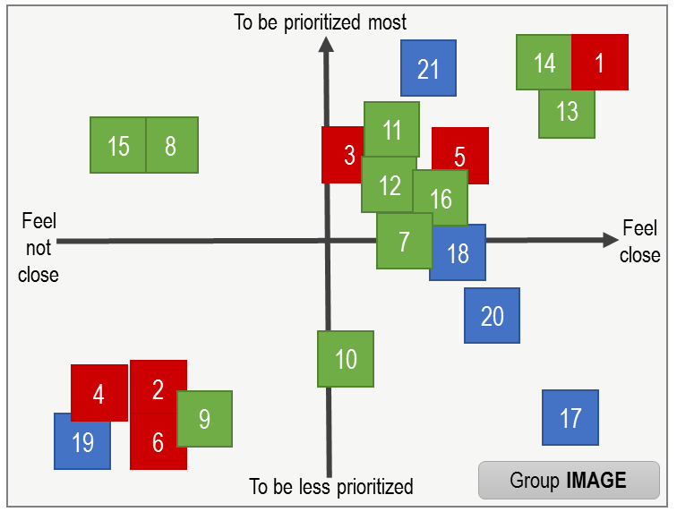
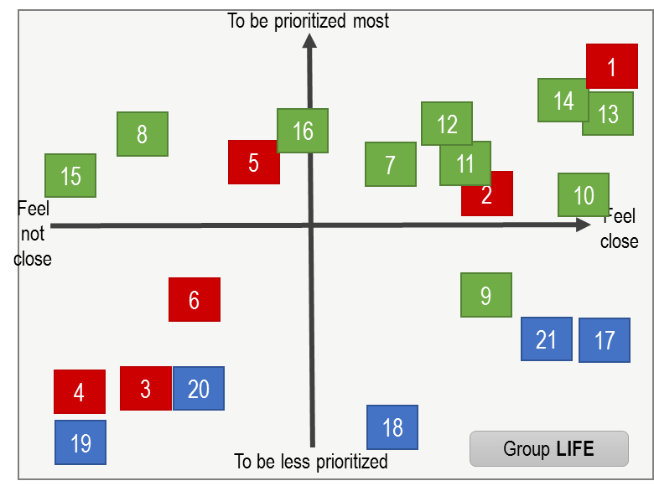
Results (matrix)
Background
Method
Results
Objective
Discussions
Conclusion & Next
Group CLIMATE
Group RIVER
Group FISH
Group IMAGE
Group LIFE

Slide 11
Results (matrix)
Background
Method
Results
Objective
Discussions
Conclusion & Next
Provisioning service
Functions of direct use in daily life (e.g. water, fish, crops):
→ “important”
Functions that are not often used
→ “not close” and “less important”
c.f. Millennium Ecosystem Assessment report
Regulating service
Most of the functions
→ “important”
Functions that are particularly related to disaster risk mitigation (flood mitigation capacity, climate mediation, buffer capacity)
→ “not close,” but “important”
Culture service
Many of the functions
→ “less important” but “close”

Slide 12
Results (presentation and discussion)
Background
Method
Results
Objective
Discussions
Conclusion & Next
Regulating service
e.g. Flood/drought control, Buffer zone, Climate mediation
“Important” and “not close”
Why “not close”? → Too large or too abstract to see
“Important” = Need a strategy to conserve/protect
“Not close as it is too large” = Protect/Conserve what?
Need to know what natural environment we have had nearby

Slide 13
Discussion
Background
Method
Results
Objective
Discussions
Conclusion & Next
Regulating service functions
Flood mitigation capacity
Climate mediation
Ecotone buffer capacity
“Important”= Need a strategy to conserve/protect
“Not close as it is too large”
= Protect/Conserve what?
Regulating service functions would be effective contents to be employed for awareness-raising of local environment.
Tangible environment of regulating service function that exist in the area
Historical disaster experience
Accumulation of natural events
Local area names

Slide 14
Discussion
Background
Method
Results
Objective
Discussions
Conclusion & Next
Disaster Education
(evacuation drills, walking-in-town, town mapping)
fast
Human activities
Narrative approach
(story telling, reading stories)
= “It’ll never happen to me.”
(Burningham et al., 2008)
Land use,
built environment
Speed of change
Infrastructure
Social schemes, culture and convention
Environmental Education
(Interaction with nature)
slow
Nature
Area name &
Local environmental background
Source: Okada, et al. (2006)

Slide 15
Conclusions
Background
Method
Results
Objective
Discussions
Conclusion & Next
Regulatory service functions are “important.”
Though students perception to regulatory service functions are recognized ”important”; hence these would be a useful/effective contents to be employed with priority;
Local environmental background
Yet, students do not feel close to such functions as those scales are too large. Historical disaster experience and area names as local environmental background may be able to play a role to bring young generation aware of connection between their daily life and local ecosystem which can bring them both benefits and risks; and
For long-term preparedness and resilience
It is vital to build such basic understanding on ecosystem functions for future long-term preparedness, which will enhance resilience and sustainability in low probability and medium-high consequence zones.

Slide 16
References
Bruner, J.S. (1960). The process of education. Cambridge, MA: Harvard University Press. Bruner, J. S. & Postman, L. (1949). On the perception of incongruity: A paradigm. Journal of Personality. 28(2), 206-223. DOI: 10.1111/j.1467-6494.1949.tb01241.x
Burningham K, Fielding J, Thrush D. (2008) ‘It’ll never happen to me’: understanding public awareness of local flood risk. Disasters 32, 216–238. DOI: 10.1111/j.1467-7717.2007.01036.x.
ILEC – International Lake Environment Committee Foundation (2007) How Can We Stop Degradation of the World’s Lake Environments? Integrated Lake Basin Management: An Introduction. International Lake Environemnt Committee Foundation: Kusatsu, Japan.
Lave, J. and Wenger, E. (1991) Situated Learning – Legitimate Peripheral Participation. Cambridge University Press, New York; USA
Okada, N., Yokomatsu, M., Suzuki, Y., Hagihara, Y. Tatano, H., and Hatayama, M. (2006) Urban Diagnosis as a Methodology of Integrated Disaster Risk Management. Annuals of Disas. Prev. Res. Inst., Kyoto Univ., 49C, 1-7
Peduzzi, P., Estrella, M., Velegrakis, A., Chatenoux, B. and Kluser, S. (2010) Linking Ecosystems to Risk and Vulnerability Reduction: The Case of Jamaica - Pilot Results from RiVAMP. UNEP Post-Conflict and Disaster Management Branch (PCDMB); United Nations Environment Programme. DEWA/GRID-Europe. (UNEP/DEWA/GRID). http://www.preventionweb.net/files/13205_RiVAMPexsummary.pdf [last accessed on 20/12/2015]
Renaud, F.G., Sudmeier-Rieux, K., and Estrella, M. (2013) The relevance of ecosystems for disaster risk reduction, The role of Ecosystems in Disaster Risk Reduction, Renaud, Sudmeier-Rieux and Estrella (eds.), United Nation University Press.
UNISDR – United Nations Office for International Strategies on Disaster Risk Reduction (2011) Global Assessment Report on Disaster Risk Reduction: Revealing Risk, Redefining Development. Geneva, Switzerland: UNISDR.
UNISDR (2013) Global Assessment Report on Disaster Risk Reduction: From Shared Risk to Shared Value: the Business Case for Disaster Risk Reduction. Geneva, Switzerland: UNISDR.
UNISDR (2015) Global Assessment Report on Disaster Risk Reduction: Making Development Sustainable: The Future of Disaster Risk Management. Geneva, Switzerland: UNISDR.
UNEP - United Nations Environment Programme (2014) Disaster risk reduction is an integral objective of environment related policies and plans, including for land use natural resource management and adaptation to climate change. Background Paper prepared for the 2015 Global Assessment Report on Disaster Risk Reduction. Geneva, Switzerland: UNISDR.
UNESCO – United Nations Educational, Scientific, and Cultural Organization (2014) Roadmap for Implementing the Global Action Programme on Education for Sustainable Development. Paris, France: UNESCO.

Slide 17
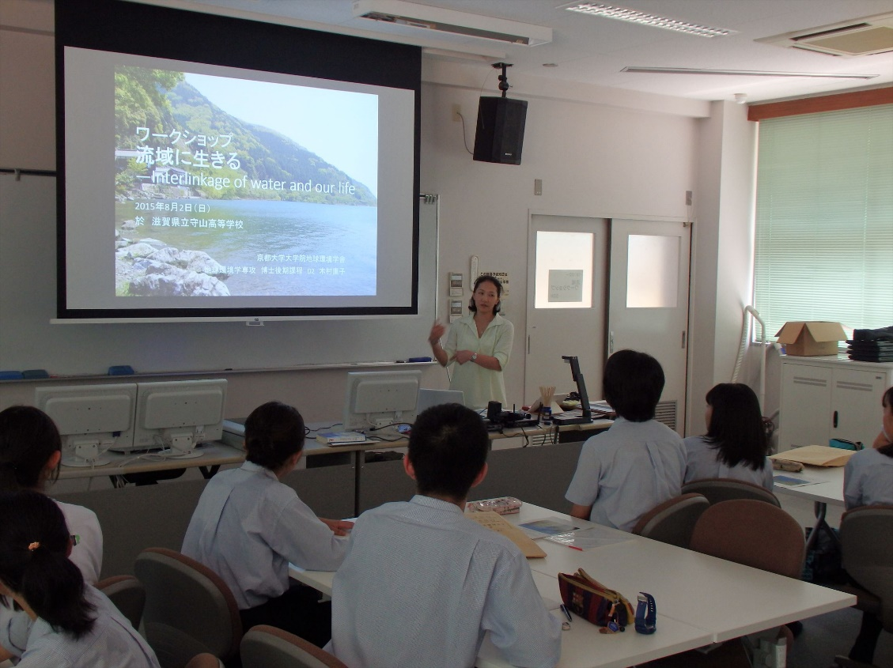
Thank you very much for your attention.

