Slide 1
Learning from a Multinational Corporate Crisis in Cameroon The Case of Herakles Farms and Image Repair
Vincent Manzie, PhD. Student
Michigan Technological University
International Crisis and Risk Communication Conference, Orlando, Florida, 7-9 March, 2016

Slide 2
Herakles Farms in Cameroon The Project
Initiated in 2009 to produce palm oil in Southwestern Cameroon.
200,000, 73.000, 20,000 hectares of land leased by government.
Project has been the site of oppositional struggles.
Stoppage order.

Slide 3
The project: A complex exigence
Land Ownership (colonial legacy; ancestral, farmland)
Environmental Stewardship (non-compliance with guidelines on environmental protection)
Multinational Authority (charges of abuse of power)
Governmental Corruption (land deals as sources of capital, personal wealth)

Slide 4
Stakeholders
Government of Cameroon (monitoring, regulating body)
Herakles Farms corporate offices and agencies
Local Communities (Villagers)
Indigenous NGOs (local activists)
Herakles Farms’ local employees
local opinion leaders, chiefs and politicians (mediators)
Local media (press, local journalists)
Herakles investors/stockholders
International environmentalists (Greenpeace, Oakland Institute)

Slide 5
Benoit’s (1995, 1997) Image Repair/Crisis Management Strategies
Multinational seen as land grabber, destroying biodiversity, illegal forest exploitation.
Multinational is seen taking away livelihood; amassing resources that belong to communities.
Two conditions for crisis
Accused is held responsible for an action
The act is considered offensive

Slide 6
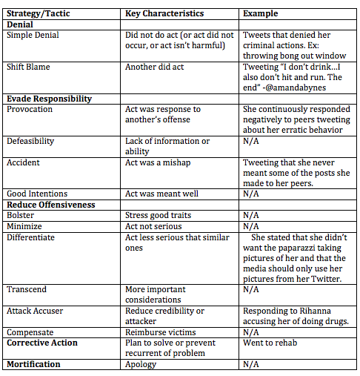
Image Repair
Benoit’s 5 typologies

Slide 7
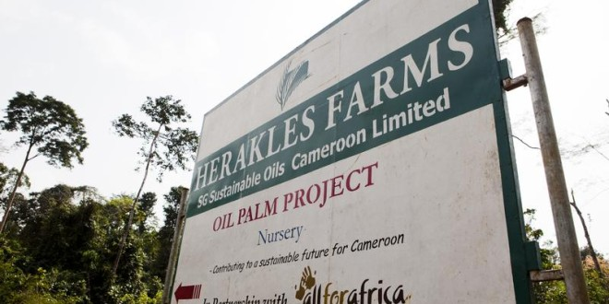
Method: Rhetorical Analysis of company documents
22 documents in which Herakles responded:
14 Press Releases
1 “Open Letter”
3 Court rulings
4 newspaper clips

Slide 8
Findings/Evidence
“Support is generally wide spread”
“none of the distribution maps showing important areas of birds, mammals, reptiles, amphibians and plants showed the project site as important biodiversity conservation site.”
“Herakles farms has a long-term agreement with the government of Cameroon…all necessary consents, approvals and permits required to operate legally within the country.”
“We do not have the right to arrest but we do have the right to detain…someone who has entered our premises with the intent to steal property”
Herakles Farms’ rhetoric of denial on:
Opposition to palm oil project
On biodiversity destruction
On corruption charges
On abuse of power/authority (undermining gov’t authority, intimidating local people)

Slide 9
Denial Strategy Failed
Not only did it not persuasively counter charges but provoked more intensified condemnations by NGOs and local and international media.
Results:
Shareholder concern
Project halted and main offices in Cameroon were closed.

Slide 10
Theoretical implications
Benoit’s image repair failed to address the complexities and exigencies in this Cameroonian case.
Limited by a traditional rhetorical conceptions
Framed by Western logics and persuasive relationships
We need an Afrocentric model of corporate crisis communication

Slide 11
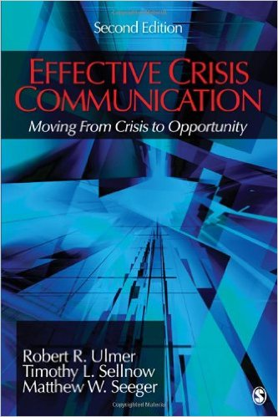
Recent events evidence a discourse of renewal
January 19, 2016: A joint government commission to reassess Herakles’ abandoned project
Features of renewal:
Organizational learning
Ethical considerations
Prospective vision
Effective organizational rhetoric

Slide 12
Shareholders and Smallholders
Recent media communiques emphasize new shareholder perspectives and inclusion of smallholders centrally in the project as well as more refining capacity and the larger need to redress a national shortage of palm oil
Organizational learning: new perspectives that change how the company understands its relation to smallholders and management of local labor
Is there evidence that Herakles is now including rather than exploiting smallholders?
Ethics: Rhetoric of denial sought to deflect blame and responsibility rather than engaging with stakeholders cooperatively. Significant choice was reduced through denial. Post-crisis, Herakles must reposition its damaged image.
Ethical claim is now responsible stewardship in being responsible to forests, local authorities, and workers
Prospective vision: Optimism overwhelmed the company’s pre-crisis position. In post-crisis rhetoric, optimism remains dominant.
Earlier, promises of solving food and labor shortages
Currently, promises of solving oil shortages
Effective rhetoric: what does this mean in the African context?
The emergence of “cultural rhetorics”: culture, place, and peoples beyond Greek traditions and Western alternatives
Postcolonial and decolonial arguments about African rhetorics
Relation of corporate voice/persona and Cameroonian actors/rhetors
The role of CEO Bruce Wrobel remains critical but can the organization’s postcolonial paternalism be tempered?

Slide 13
Emerging outline of African Communication Theory
Communalism as paradigmatic (Faniran; Christian)
Morality as normative and instilled in social/communal/kinship relations (Famakinwa; Ikuenobe; Oyowe)
Centripetal flows and relations in tension with centrifugal/post- and neo-colonial structures
Indigenous forms as knowledge practices (Ansu-Kyeremeh)
Grassroots participation as basis for socio-political-economic traditions/authority (White)
Hybridity or willingness to incorporate external elements to create novel forms (consumerism; hybrid forms of performance and narrativity as public rhetoric)

Slide 14
Improvisation and Hybridity
The framework of improvisation/renewal discourse needs to be re-articulated, re-conceptualized following exigencies within African communities.
Epistemologically and politically improvisation/renewal must be reframed within a communalism perspective identified with Afrocentric ontology/epistemology
Improvisation emerges within community rather than as an expression of individual creativity to/for the community
Hybridization, reterritorializations, and border spaces
Historical, political, social, and religious stratifications and marginalizations are exigencies that bring up hugely different needs and expectations that can not be adequately addressed through Western rationalities.
Canclini: “sociocultural processes in which discrete structures or practices, previously existing in separate form, are combined to generate new structures, objects, and practices” (p. xxv)
Example: Indigenous knowledge and practices regarding land use and labor in sub-Saharan Africa (Ajani, et al., 2013; Liddel, et al., 2005)

Slide 15
Conclusion
The renewal/improvisational framework as explained in current studies of organizational crisis communication emphasizes good leadership (e.g., the ability of the leader to inspire), and is ethical, prospective, and provisional in nature. The goal is to make use of opportunities inherent in crisis such that organizations can renew. But how these components can be articulated in African contexts is still to be explored. We need to extend this theory to purely African organizational crisis communities to understand how the theoretical components are manifested, and by extension, explore how African histories, cultural, economic, and political exigencies impact the renewal/improvisational approach. In this way, a more robust perspective of the renewal framework will be developed.

Slide 16
Vincent Manzie
Michigan Technological University

