Slide 1
Saudi Arabia's Efforts to Correct the West's Image of Islam: A Critical Assessment
Osama Albishri

Slide 2
Overview
What is the current image of Islam and Muslims among the Western societies?
What efforts have been made by Saudi Arabia to correct the image of Islam and the West?
What Saudi Arabia can do to improve to bridge or at least narrow the gap between the West and the Islamic World?

Slide 3
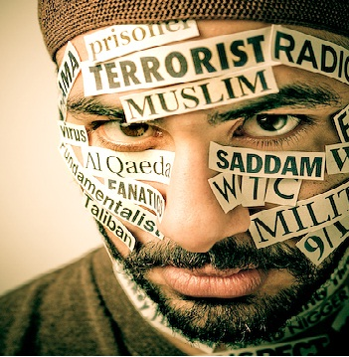
The Current Image of Islam in the Western Media
Muslims has been negatively portrayed in media since 9/11.
Media helps to normalize associating Islam and Muslims with terrorism, violence, irrationality, and vengefulness.
The Arab and Islamic World suffered from continuous campaigns of accusations, stereotypes, and misconceptions.
The event painted the entire Arab and Islamic World with a broad brush of terrorism, the Islamic world is seen as a war zone.

Slide 4
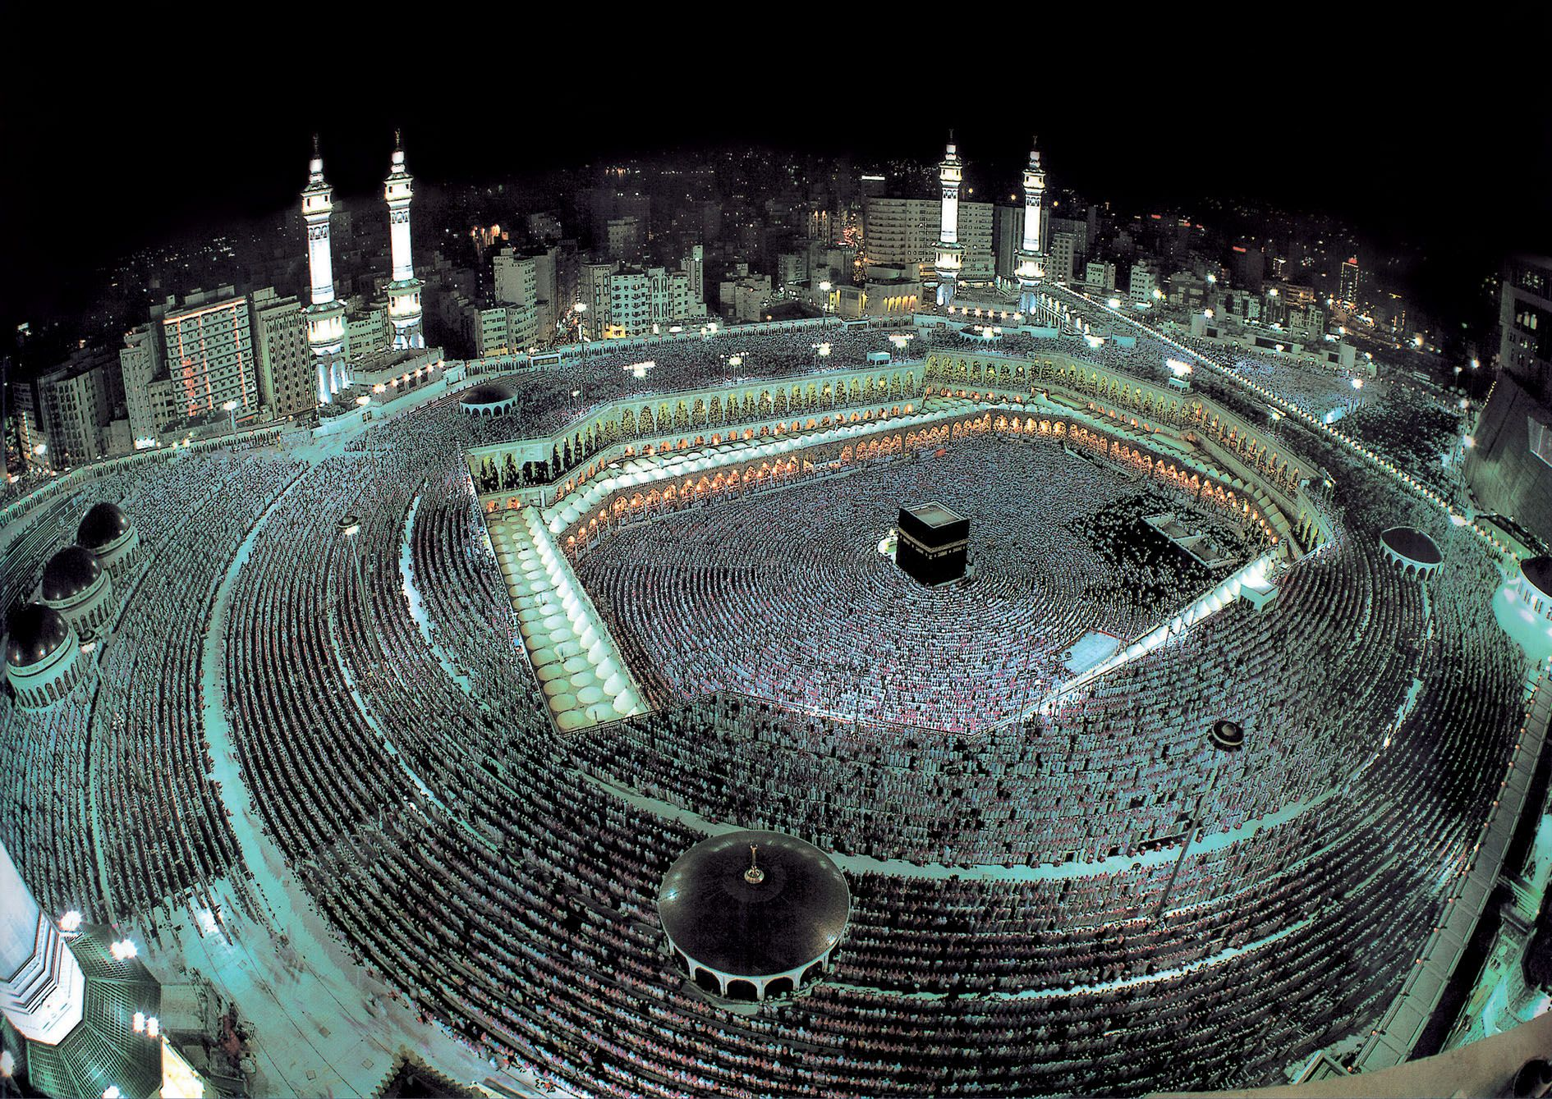
Why Saudi Arabia?
Saudi Arabia is considered one of the leading countries in the Islamic World.
It is the birthplace of Islam, and it has the most important Islamic sacred places.
Saudi Arabia has been the most accused of exporting extremism and terrorism to the region and the world by supporting extremist groups and its strong adherence to the principles of Islam.
It is financially capable of funding public campaign on an international level.

Slide 5
Ministry of Culture and Information
The media system in Saudi Arabia has been highly centralized, the Ministry of Culture and Information is responsible for regulating and censoring the media in Saudi Arabia.
Any attempt by media organizations in Saudi Arabia to conduct campaigns in international level has to be in coordinating with this ministry.
There are two institutions within the Ministry of Culture and Information that deal with international news and affairs.
The Saudi Press Agency (SPA)
The Saudi Bureau of International Communication and Media (SBICM)

Slide 6
Ministry of Foreign Affairs
It was heavily criticized for its diplomatic failure with the victims’ families of 9/11 and the Western media.
There is a lack of planning and poor execution regarding the Saudi’s public diplomacy initiatives.
There have been outstanding efforts by the Adel Al-Jubeir to appear the Western media and journalists and reject any association between Islam and terrorism.

Slide 7
Other International Initiatives
International Conferences and Seminars
The Image of Islam in the West through Curricula
The Role of Islamic Centers in Correcting Misconceptions about Islam
Islam and Peaceful Community
King Abdullah bin Abdul-Aziz International Centre for Interreligious and Intercultural Dialogue (KAICIID)
King Abdullah Scholarship Program (KASP)
The Islamic Military Counter Terrorism Coalition

Slide 8
Is it Enough?
Despite all the efforts that Saudi Arabia has done enough to correct the image of Islam and Muslims based on its leading role in the Islamic world and its financial capability.
These efforts have not yet met the ambitions nor aspirations that Muslims are waiting from Saudi Arabia.
Amongst many reasons, the lack of planning and the absence of vision are two main obstacles that limit and weaken the efforts of Saudi Arabia to correct the image of Islam in the West.

Slide 9
How to Bridge the Gap?
Saudi Arabia should have a meaningful scheme to defend Islam in the Western mainstream media by adopting media strategies coupled with ambitious plans to compete with the international media companies.
Saudi Arabia must consider building its media empire, by investing a significant amount of money on infrastructure and training of media personnel.
It needs to establish its international broadcast to compete with others that have been dominating the flow of international news.
Saudi Arabia must consider opening its movie industry in a similar fashion to Hollywood and Bollywood in order to provide movies that depict the social lives of Saudi and Muslim communities, with translations into multiple to reach a broad range of audiences.
All the strategies mentioned above will be difficult to apply if they are not combined with a reduction of government censorship and bureaucratic procedures.

Slide 10
Thank you for you attention☺

