Slide 1
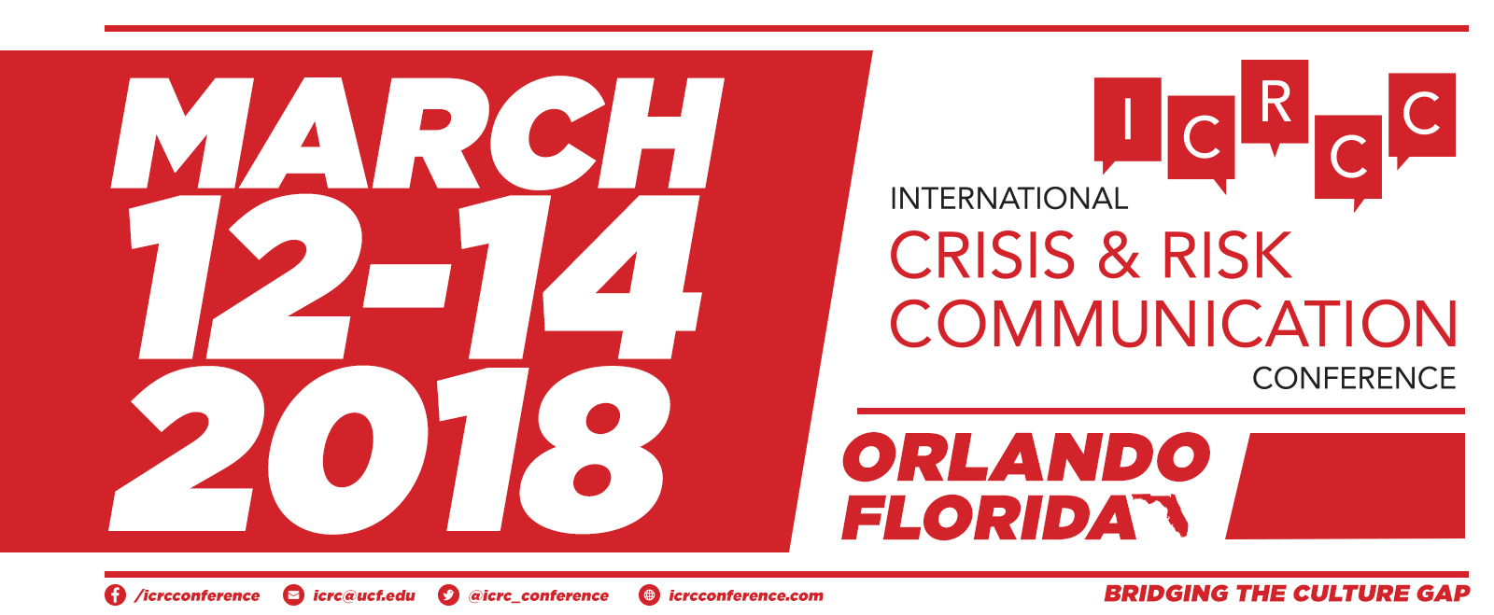
Implementing STREMII: A practical guide for crisis communication on social media during hurricanes and natural disasters
Margaret C. Stewart & Cory Young

Slide 2
AGENDA
Introductions
Presentation Outcomes
Refresher on STREMII Models
Practical Recommendations
Social Listening
Engagement
Examples
Next Steps
Questions?

Slide 3
Presentation Outcomes
Identify the elements of STREMII
Recognize the practical applications of social listening and responsive engagement in crises – specifically, in the context of hurricane disasters.
Discuss next steps and potential pathways for STREMII application and discovery.

Slide 4
Original STREMII Model (2015)
Six Elements
(1) surveillance & social listening
(2) identify target audiences
(3) respond to the crisis & engage in the conversation
(4) monitor the landscape & evaluate outcomes
(5) interact with consumers & publics
(6) implement necessary changes

Slide 5
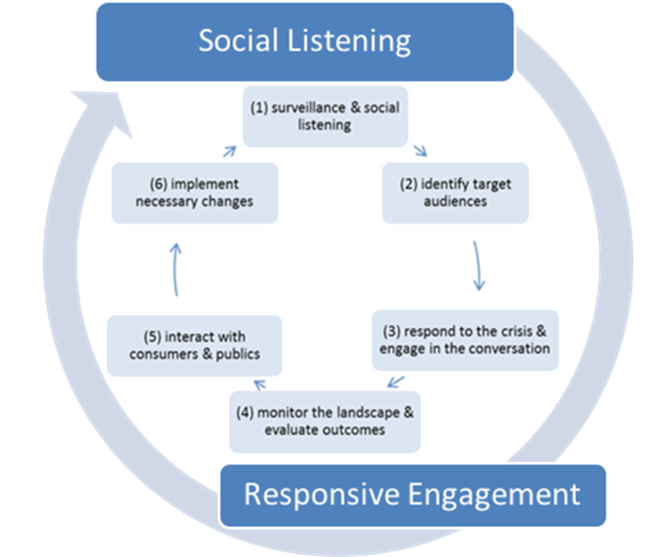
Revised STREMII Model (2017)
Six Elements
Two Ongoing Elements

Slide 6
Getting Started with Social Listening
Use platform-specific features to engage in listening:
Twitter – Advanced Search
Facebook – FB Insights
Hootsuite – Vidpiq for Instagram
Develop a critical & comprehensive list of Keywords & Hashtags
Examine your existing tools and evaluate emerging tools
Develop routine listening habits & refine them routinely
Demonstrate listening through engagement (Be useful; Add value)
Encourage listening across the organization
Create jargon-free search terms & refine your search queries routinely to eliminate irrelevant results

Slide 7
Considerations for Responsive Engagement on Social Media during Crisis
The International Federation of Red Cross and Red Crescent Societies (2017) released a guide for using social media during humanitarian crisis events. The following recommendations are made for effective online response:
Produce timely, actionable and useful content that meets your audience’s needs (Reinforce = Be useful; Provide value)
Respond in a prompt and timely manner
Make the feedback loop visible (Be transparent)
Manage expectations
Identify new influencers
Manage rumors & misinformation
If you can’t help, determine who
can and pass information forward

Slide 8
STREMII Recommendations
Avoid “rapid replace”:
Use Social Listening and evaluation/measurement to determine what is/not working with response & engagement
Prepare with the process:
Anticipate crises as best as possible
Recognize (potentially) changing (placement) of target audiences
Prepare crisis messages readily and be ready to adjust according to the crisis
Integrate organically :
Rely on your relationships in crisis (Relationship-building, authenticity, influencers)
Assess the crisis threats to your brand/organization to determine what is best
Adapt STREMII to the needs of your industry, organization, location, etc. AND the specific crisis event

Slide 9
Examples & Next Steps
Examples
Pragmatic implementation:
Model requires further testing/evaluation
“Hurricanes only” crisis communication model
Other practical applications
Extended research on the power of Social Listening

Slide 10
Questions?
m.c.stewart@unf.edu
youngc@ithaca.edu
THANK YOU! ☺

Slide 11
References
Coombs, W.T. (2014). Ongoing crisis communication: Planning, managing, and responding, (4th ed.). Thousand Oaks, CA: Sage Publications, Inc.
Coombs, W.T. (2007). Protecting organization reputations during a crisis: The development and application of situational crisis communication theory. Corporate Reputation Review, 10(3), 163-176.
Fink, S. (1986). Crisis management: Planning for the inevitable. New York: Amacom.
The International Federation of Red Cross and Red Crescent Societies (2017). How to Use Social Media to Better Engage People Affected by Crises. Retrieved from: https://www.icrc.org/.../57272/icrc-ifrc-ocha-social-media-guide.pdf
Mitroff, I.I. (1994). Crisis management and environmentalism: A natural fit. California Management Review, 36(2), 101-113.
Seeger, M.W., Sellnow, T.L., and Ulmer, R.R. (2003). Communication and organizational crisis. Westport, CT: Praeger.
Seeger, M.W. (2006). Best practices in crisis communication: An expert panel process. Journal of Applied Communication Research, 34(3), 232-244.
Stewart, M. C., & Gail Wilson, B. (2015). The dynamic role of social media during Hurricane #Sandy: An introduction of the STREMII model to weather the storm of the crisis lifecycle. Computers in Human Behavior, 54, 639-646.
Stewart, M.C. and Young, C. (March, 2017). Revisiting STREMII: An application of social media crisis communication during Hurricane Matthew; Paper Presentation. International Crisis & Risk Communication Conference; Orlando, FL.

