Slide 1
Guiding Institutional Efforts to Promote STEM Faculty Diversity
A Conceptual Model and Self Assessment Tool
K. Griffin & A. Mabe
APLU INCLUDES

Slide 2
Presentation Goals
Provide an overview of an integrated framework focusing on institutional efforts to increase faculty diversity
Show how the model can be used to frame criteria against which institutions can assess their efforts to promote faculty diversity
Start a conversation about how these ideas can be used to engage in collective impact, developing strategies to increase faculty diversity across partner institutions

Slide 3
1. Explaining the Framework and its foundation in scholarship and practice
How do we increase and maintain faculty diversity at the institutional level?
How do we shift attention to institutional challenges and efforts to increase diversity?

Slide 4
Existing Conversations About Challenges to Increasing Faculty Diversity
“It’s a pipeline problem” – the number of people from underrepresented groups receiving STEM PhDs is too small (Eagan et al., 2014; Knowles & Harleston, 1997; National Academies, 2016)
“It’s a hiring problem” – implicit bias, a lack of effort and commitment, and structural racism keep institutions from hiring faculty from diverse backgrounds (Hill, Corbett, & Rose, 2010; Kulis, Shaw, & Chong, 2000; Reuben, Sapienza, & Zingales, 2014)
“It’s a retention problem” – faculty from underrepresented groups are less likely to get tenure and more likely to leave their institution and the professoriate (Jayakumar et al., 2009; Stanley, 2006; Turner et al., 2008)

Slide 5
Limitations Of Our Current Conceptions and Diversity Efforts
Conversations about why faculty diversity is so difficult usually identify and focus on one of the three challenges, leading to singular strategies to addressing a complex problem
Challenges are often mistakenly seen as outside of an institution’s control, more often due to individual will and ability
A lack of faculty diversity is an institutional problem and a STEM problem, which makes it hard to generate institutional level solutions, especially without collaboration

Slide 6
Reframing These Conversations
Increasing faculty diversity at the institutional level is a multidimensional process which requires attention to:
Recruitment – hiring a diverse pool of faculty
Transition – supporting new faculty as they enter the institution
Retention – providing resources and support which allow faculty to develop skills, feel a sense of belonging on campus, and navigate the tenure and promotion process.
While actions can and must take place at the institutional level, progress requires:
Understanding that much of the work must take place at the college and departmental level
Leveraging external networks, partnerships, and networks to generate and support a diverse faculty body

Slide 7
INSTITUTIONAL CONTEXT (location, culture, climate, institutional commitment to diversity, institutional commitment to assessment and data informed practice, senior administrators and trustees)
RECRUITMENT
(bringing new faculty to the institution)
OUTREACH
(long term efforts to build pool)
HIRING
(process, selection, and short term pool development)
YIELD
(getting applicants to accept offers)
TRANSITION
(fostering smooth and welcoming entry into the institution and campus community)
RETENTION
(keeping faculty at the institution)
PROFESSIONAL DEVELOPMENT
(building skill and professional development in teaching, service, and research)
ADVANCEMENT
(promoting successful navigation of promotion and tenure policies and processes)
SATISFACTION AND SUPPORT
(addressing sense of belonging and community, work-life balance, and satisfaction)

Slide 8
RECRUITMENT
(identifying and hiring new faculty)
OUTREACH
(long term efforts to build pool)
HIRING
(process, selection, and short term pool development)
YIELD
(getting applicants to accept offers)
Outreach
Emphasis on long term pool development strategies and initiatives
Women and URM science trainees report less interest in academic careers (Gibbs & Griffin, 2013; Gibbs et al., 2014), increasing diversity will require more individuals from URG to pursue and obtain faculty positions (Gibbs et al., 2016)
Hiring
Implicit bias and a lack of clarity about what affirmative action policy means in practice can diminish diversity efforts on search committees (Hill, Corbett & Rose, 2010; Muniz, 2012; Reuben, Sapienza, & Zigales, 2014)
Strategies often focus on hiring, and little research has validated their success, but some suggestion that placing emphasis on diversity are a priority, implicit bias training, cluster hires, and strategic advertisement can increase diversity of applicant pool and hires (Collins & Johnson, 1988; Glass & Minnotte, 2010; Kayes, 2006; Smith, et al., 2004)
Yield
Hiring does not mean individuals will actually accept the position
Institutions send signals that diverse candidates are “hard to get” and too costly (Kulis, Shaw, & Chong, 2000; Tuitt, Sagaria & Turner, 2007)

Slide 9
TRANSITION
(fostering smooth and welcoming entry into an institution and campus community)
Less explored or discussed as part of the recruitment or retention process
Can be a long period of time between hiring (as early as December or January) and first day on campus (August or September)
Transitions can be stressful, even when positive (Evans et al., 2010)
Ability to cope with transition is influenced by internal and external resources available (Schlossberg et al., 1995)

Slide 10
RETENTION
(keeping faculty)
PROFESSIONAL DEVELOPMENT
(building skill and professional development in teaching, service, and research)
ADVANCEMENT
(promoting successful navigation of tenure and promotion policies and processes)
SATISFACTION AND SUPPORT
(addressing sense of belonging and community, work-life balance, and satisfaction)
Professional Development
Challenges with access to mentors and senior scholars as collaborators (Hess, Gault, & Yi, 2013; Tuner & Myers, 1999; Zambrana et al., 2015)
Women and faculty of color carry heavier teaching and service loads, potentially with a negative impact on productivity and advancement (Eagan & Garvey, 2015; Griffin, 2012; Porter, 2007)
Advancement
Specific to challenges navigating the tenure and advancement process (Fox & Colatrella, 2006; Tierney & Bensimon, 1996)
Lack of clarity and consistency in policy (Fox & Colatrella, 2006; O’Meara, 2011; Piercy et al., 2005)
Bias and challenges in consistent evaluation, with limited attention to service and teaching (Hess, Gault, & Yi, 2013; O’Meara, 2011)
Satisfaction and Support
Satisfaction with work-life is connected to intentions to leave (Rosser, 2004)
Challenges with climate, stereotypes, bias, and discrimination can diminish sense of belonging and productivity (Blackwell, Snyder, & Mavriplis,2009; Eagan & Garvey, 2015; Griffin et al., 2011; Jayakumar et al., 2009; Stanley, 2006; Turner et al., 2008)
A lack of work-life balance and satisfaction with faculty life can push individuals from URG out of the academy and have negative implications for the tenure and promotion process (Perna, 2005)

Slide 11
INSTITUTIONAL CONTEXT (location, culture, climate, institutional commitment to diversity, institutional commitment to assessment and data driven practice)
RECRUITMENT
(bringing new faculty to the institution)
OUTREACH
(long term efforts to build pool)
HIRING
(process, selection, and short term pool development)
YIELD
(getting applicants to accept offers)
TRANSITION
(fostering smooth and welcoming entry into the institution and campus community)
RETENTION
(keeping faculty at the institution)
PROFESSIONAL DEVELOPMENT
(building skill and professional development in teaching, service, and research)
ADVANCEMENT
(promoting successful navigation of tenure and promotion policies and processes)
SATISFACTION AND SUPPORT
(addressing sense of belonging and community, work-life balance, and satisfaction)

Slide 12
Institutions Are Nested in Context – Different Actors Have Roles at Different Levels Which Influence and Shape Faculty Experiences and Strategies to Promote Diversity
Departments
College
Institution
Deans
Faculty
Department Chairs
President
Provost
Faculty Senate
College Promotion and Tenure Committee
Students
University Promotion and Tenure Committee
Trustees
Faculty Union
Department Promotion and Tenure Committee
Department Staff and Administrators
Notes:
Different stakeholders will have a different level of influence on the model – will be able to address different components of the model in different ways . . .
There could be an excel worksheet for each box of the model and what can be done to influence it at each level. For example – what can be done at the super system, system, institution, college, and departmental level to influence hiring.

Slide 13
2. Presenting an institutional self study, guided by the framework
How can this model be used to guide institutional assessment of progress towards increasing faculty diversity?

Slide 14
Structure of Self Assessment
Types of Information
Sections of the Tool
Integrates qualitative and quantitative data
Institutional data (represented in red)
Disaggregated by department, race, gender, rank, and status (tenure-track vs. non-tenure-track)
This should be done to the extent possible; however, where data are not available, it should be noted.
Engagement in practices (yes/no and open ended responses)
Assessments of progress and areas of improvement in implementing policies and practices
Data Collection Template
State of campus diversity and overarching descriptive data on student enrollments and faculty hiring and departures
Campus Questionnaire
Efforts to promote faculty diversity
Questions assessing engagement in specific activities
Reflection on strategies
Open ended responses that allow institutional leaders to reflect on process, progress, and areas for continued growth and development

Slide 15
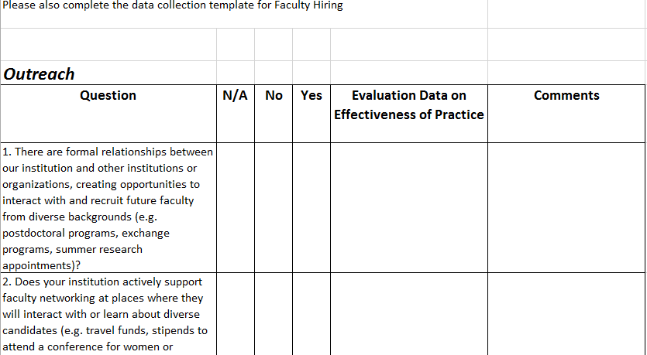
Structure of Campus Questionnaire

Slide 16
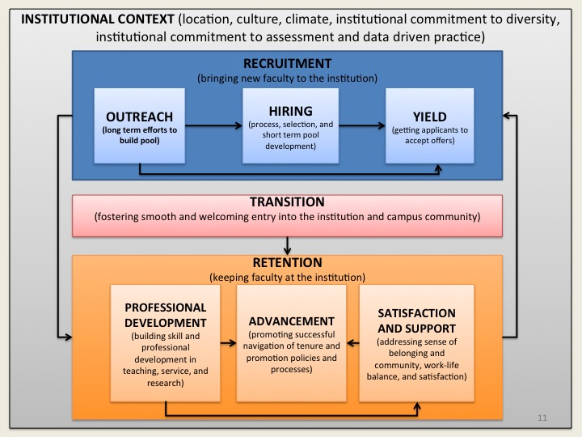
Content of Self-Assessment Tool
Institutional Model for Increasing Faculty Diversity
Each section of the Campus Questionnaire aligns with a dimension of the model
4 questionnaire sections:
Institutional Context
Recruitment (Outreach, Hiring, and Yield)
Transition
Retention (Professional Development, Advancement, and Satisfaction and Support)
1 reflection section documenting strengths, challenges, and next steps

Slide 17
Institutional Context Questions
1. Is diversity and/or equity mentioned in the university mission statement?
2. Is diversity and/or equity highlighted in the strategic plan?
3. Is there a specific diversity strategic planning process?
4. Is/are there institutional committee(s), working group(s), or task force(s) charged with exploring and addressing diversity and equity issues on campus?
5. Did or does your campus have an ADVANCE program?
6. Do you have a Chief Diversity Officer or senior level administrator (reporting to the president or provost) tasked with developing and directing institutional diversity and equity initiatives?
7. Is there a university level administrator responsible for coordinating and directing diversity and equity initiatives?
8. Have there been recent (last 3 years) protests or public discussion on campus focused on faculty diversity?
9. Have you completed a campus-wide climate assessment in the past 3 years?

Slide 18
Institutional Context Questions
10. Have you completed a campus-wide assessment or survey of faculty work-life, experiences, and/or satisfaction in the past 3 years ?
11. Has your board of trustees (at the institutional or system level) clearly articulated a commitment to or goals related to diversity and equity?
12. Have institutional level goals for diversity in faculty hiring been set?
13. Have institutional level goals for diversity in faculty tenure, promotion, and advancement been set?

Slide 19
Recruitment/Outreach
1. There are formal relationships between our institution and other institutions or organizations, creating opportunities to interact with and recruit future faculty from diverse backgrounds (e.g. postdoctoral programs, exchange programs, summer research appointments)?
2. Does your institution actively support faculty networking at places where they will interact with or learn about diverse candidates (e.g. travel funds, stipends to attend a conference for women or underrepresented scientists)?
3. Have specific departments or the college developed structured relationships with industry partners that have been leveraged to recruit prospective applicants from diverse backgrounds?
4. Are you participating, either alone or in collaboration with other institutions, in a structured postdoctoral program that aims to increase diversity in the professoriate?
5. Have you developed and implemented strategic initiatives to recruit recent alumni that have not yet established their reputations at other institutions or initiated “grow your own: programs where recent alumni are hired into faculty positions?
6. Is there a senior administrator at the campus level responsible for coordinating outreach efforts or outreach programs, independent of individual searches?
7. Have you developed and implemented strategic initiatives to maintain relationships with alumni to recruit them or their students?

Slide 20
Recruitment/Hiring Questions
1. Is there an institutional or college level policy requiring an affirmative action briefing for all search committees?
2. Is there an institutional or college level policy requiring implicit bias training for all search committees?
3. Are search committees required to submit their recruitment plans and strategies to address diversity of the pool to the College or institution for approval?
4. Are search committees given guidance on how to assess candidates based on standard and non-standard metrics of success (e.g. contribution to campus diversity, community engagement, engaged pedagogy)?
5. Have cluster hires been used as a strategy to increase diversity in the STEM disciplines?
6. Is there a centrally organized program that allows departments and colleges to engage in “target of opportunity hires,” or recruit scholars that can contribute to campus and/or departmental diversity goals?
7. Are there institutional level incentives offered by the President, Provost, or Dean(s) to increase diversity in faculty hiring?

Slide 21
Recruitment/Yield Questions
1. Do you track effectiveness of offers and hiring strategies through an assessment of yield data at the institutional level?
2. Is information formally collected on why offers are not accepted?
3. Is information formally collected on why offers are accepted?
4. Are opportunities to connect with affinity groups (e.g. women faculty, Black faculty and staff association) on campus and in the community offered to prospective hires and incorporated into the recruitment process?
5. Is there a website, office, or resource guide that offers information regarding the surrounding community that is widely shared with prospective hires?
6. Is there an office or administrator responsible for assisting partners with job searches and securing employment?

Slide 22
Transition Questions
1. Is there a website, resource guide, or office which offers housing information and resources?
2. Is there an institutional-level new faculty orientation?
3. Is there a specialized orientation for new STEM faculty?
4. Are new faculty provided with access to mentors prior to beginning their academic appointment?
5. Are there opportunities for new faculty to apply for institutional funding or seed grants prior to beginning their academic appointment?
6. Are there centrally organized opportunities for new faculty to participate in professional development activities and/or workshops prior to beginning their academic appointment?
7. Is there a website, resource guide, or office which addresses common concerns for new faculty?

Slide 23
Retention/Professional Development Questions
1. Is there a formal mentoring program, policies, or guidelines addressing the mentoring of new faculty at the university, college, or department level?
2. Is there a mentoring program, policy, or guidelines for associate professors at the institutional, college, or department level?
3. Does the institution, colleges, or departments offer mentors centrally organized opportunities to participate in training or get access to resources to improve their practice?
4. Are there incentives offered to senior faculty to serve as mentors?
5. Do you offer centrally organized opportunities and/or incentives for senior faculty to support and collaborate with junior faculty on writing and research?
6. Are there institutional and/or college level opportunities to apply for and receive:
pre-tenure leave/sabbatical?
small grants/seed funding?
summer research awards and stipends?
7. Are there centrally organized training opportunities and resources available specific to meeting the needs of STEM faculty?
8. Are there structured opportunities and resources available which address the unique challenges faced by faculty who are women?
9. Are there centrally organized opportunities and resources available which address the unique challenges faced by faculty who identify as Black, American Indian, Latina/o/x, or Native Hawaiian/Pacific Islander?
10. Are there workshops and programming offered to support faculty in:
scholarly writing?
grant writing?
teaching?
mentoring and advising?
engagement in institutional, professional, and community service?
navigating institutional policies and culture?
balancing teaching, research, and service obligations?
11. Do you collect data on faculty use of support services and professional development resources?
12. Do you collect data on faculty satisfaction with availability and quality of support services and professional development resources?

Slide 24
Retention/Advancement Questions
1. Is there a centrally organized yearly review process, where faculty discuss their progress towards promotion and/or tenure with their department chair or dean?
2. Are there published guidelines that clearly communicate the criteria and necessary benchmarks candidates must achieve to receive tenure and/or promotion?
3. Are there centrally organized measures in place to ensure that all faculty have access to specific departmental guidance and support in navigating the guidelines for tenure and promotion? Including access to:
Mentors and advisors who understand the tenure and promotion process at the institution?
Workshops and information sessions?
Online resources and manuals?
Sample tenure and promotion materials?
4. Is there a formal way to evaluate and incorporate a professor's contribution to campus diversity goals and initiatives in their promotion and tenure review?
5. Are promotion and tenure committees required to complete implicit bias training?
6. Are promotion and tenure committees required to submit written summaries of their meetings and deliberations?
7. Are tenure and promotion committees provided with information and guidance about:
how to balance feedback from student evaluations, peer evaluations, and other indicators in assessing teaching quality?
criteria that can be used in assessing scholarly productivity and impact, and how those criteria should be weighted in the process?
the value of and how to consistently assess engagement in service and community action?
the unique challenges of underrepresented faculty and issues related to campus climate?

Slide 25
Retention/ Support and Satisfaction Questions
1. Do you complete exit interviews or surveys with departing faculty?
2. Are data collected from exit interviews or surveys used to develop retention programs and policies through intentional and centrally organized processes?
3. Are all campus buildings in compliance with regulations specified by the Americans with Disabilities Act?
4. Are there policies and procedures for faculty to report grievances, discriminatory experiences, and microaggressions?
5. Is there a person in the position of faculty advocate or ombudsperson?
6. Are there affinity group organizations offering support and providing resources to:
women faculty?
faculty of color?
faculty who are parents?
women of color?
faculty with disabilities?
faculty who are members of the LGBT community?
faculty caring for aging parents or relatives?
7. Does the institution have:
paid parental or family leave policies?
policies that allow faculty to stop or slow their tenure clocks?
child care locator services?
on-campus child care resources?
8. Are there organized leadership training and development opportunities for faculty?
9. Do departments track whether there is an equitable distribution of:
teaching loads?
advising loads?
committee work and other service assignments?
10. Have faculty had the opportunity to participate in surveys or assessments assessing climate, satisfaction, and/or workload?
11. Have data collected through surveys of faculty climate, satisfaction, or workload been used to develop new policies and programs to promote faculty work life?

Slide 26
Reflection on Strategies
What are the strongest/most effective strategies, policies, and programs that you have instituted in regards to:
Recruitment (at the institutional, college, and departmental levels)
Transition (at the institutional, college, and departmental levels)
Retention (at the institutional, college, and departmental levels)
Where has your institution struggled, missed opportunities, or faced challenges in regards to:
Recruitment (at the institutional, college, and departmental levels)
Transition (at the institutional, college, and departmental levels)
Retention (at the institutional, college, and departmental levels)
Based on your self assessment, what steps will you take to address the challenges you’ve uncovered?
Recruitment (at the institutional, college, and departmental levels)
Transition (at the institutional, college, and departmental levels)
Retention (at the institutional, college, and departmental levels)
What additional data or information do you need to collect to better understand the state of faculty diversity on your campus?
Recruitment (at the institutional, college, and departmental levels)
Transition (at the institutional, college, and departmental levels)
Retention (at the institutional, college, and departmental levels)

Slide 27
3. Engaging in Collective impact
How can organizations outside of institutions support campus-level efforts to increase faculty diversity?

Slide 28
Institutions Are Nested in a Larger Framework of Organizations
Departments
College
Institution
State Systems
Super Systems
Deans
Faculty
Department Chairs
President
Provost
Faculty Senate
System head (e.g. University of California Office of the President)
Governing board (e.g. University of Maryland System)
Associations (e.g., APLU)
Disciplinary society (e.g., NSBE, AWIS, ABET)
Consortia (e.g., Big 10 Academic Alliance)
College APT Committee

Slide 29
Thinking About the Engagement of State Systems and Super Systems in Efforts to Promote Faculty Diversity
Several aspects of the model may be hard to shape directly at the Super System level (e.g., hiring decisions, APT decisions, transition activities)
However, there are areas that larger systems external to campuses may have greater success (e.g., outreach, skill development)
Our tool highlights potential levers, as well as areas of institutional responsibility in the process
It is important to assess current practice and aggregation for a resource guide.
We also encourage creative thinking about the unique strengths and scope of these organizations and how they can play a role in institutional success.

Slide 30
Super Systems - Potential Opportunities for Influence
Outreach
Develop large postdoctoral programs serving multiple institutions in a super system or network
Satisfaction and Support
Build formal networks for faculty to connect and support each other (see Kerry Ann Rockquemore as an example)
Skill Development
Funding opportunities to support seed grants
Larger conferences and meetings to support teaching skills
Hiring, Yield, Transition, and Advancement
Super systems can provide tools and resources to guide best practice

Slide 31
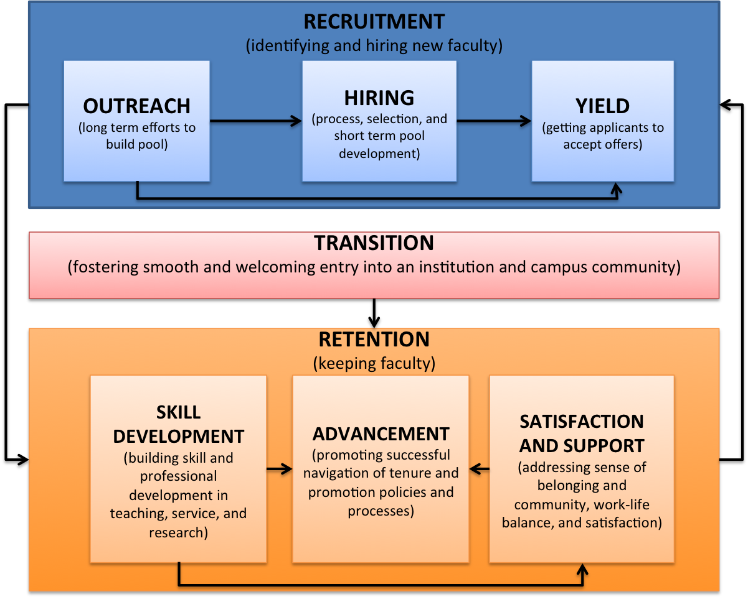
State Systems - Potential Opportunities for Influence
Outreach
Maintain a database of system doctoral alumni, area of study, productivity, and area of employment
Satisfaction and Support
Host summer conferences and retreats that allow faculty system-wide to connect
Skill Development
Create programs that foster collaboration between junior and senior scholars within the larger system
Hiring, Yield, Transition, and Advancement
System level policies that promote consistency across institutions within the group
APT processes
Implicit bias training
Institutional Model for Increasing Faculty Diversity

Slide 32
Next Steps
Where do we go from here?

Slide 33
Moving This Work Forward
Feedback
The model
The self-study tool
Should all of the data requests appear together, or throughout the document?
Wording of questions
Too much? Too little? Accessible?
Potential ways for systems and super systems to engage in this work
Identification of effective practices being employed to promote faculty diversity

Slide 34
APLU INCLUDES Faculty Diversity Task Force
M. Roy Wilson (Co-chair) | President | Wayne State University
Ruth Watkins (Co-chair) | Provost | University of Utah
Ann E. Austin | Associate Dean for Research, Professor | Michigan State University
Susan Carlson | VP for Academic Personnel and Programs | University of California Office of the President
Junius Gonzales | Senior VP for Academic Affairs | University of North Carolina System
Kiernan Mathews | Executive Director & PI, COACHE | Harvard Graduate School of Education
Lawrence Morehouse | President | Florida Education Fund
Mark Smith | Dean of the Graduate School | Purdue University

Slide 35
Please Contact Us With Ideas and Feedback
Alan Mabe
Consultant, Aspire Alliance Project
Formerly, Senior Vice President for Academic Affairs
Association for Public and Land-grant Universities
amabe@aplu.org
(919 451-7413)
Kimberly Griffin
Associate Professor, University of Maryland
kgriff29@umd.edu
(301) 405-2871

